Slide 1

Advanced Programming CMP 102
Dr. Perihan PEHLİVANOĞLU
Biruni Univarsity
Department of Computer Engineering 2023
Spring

Slide 2
Course Plan
Introduction - Functions (Recursive functions) Arrays, ArrayList, Vector
Collections (List, Queue, Stack, Set, Map, Tree)
Streams, Files
Generics and Exceptions
Midterm Exam

Slide 3
Course Plan
Visual Programming Fundamentals Designing a Form Controls and Forms Properties of Components and Events Final Exam

Slide 4

Last Lecture
We have done examples on exceptions.
We have learned to write data to a text file and read data from a file.

Slide 5
Introduction
In this lecture, we will learn binary files and then streams.

Slide 6
STREAM

Slide 7
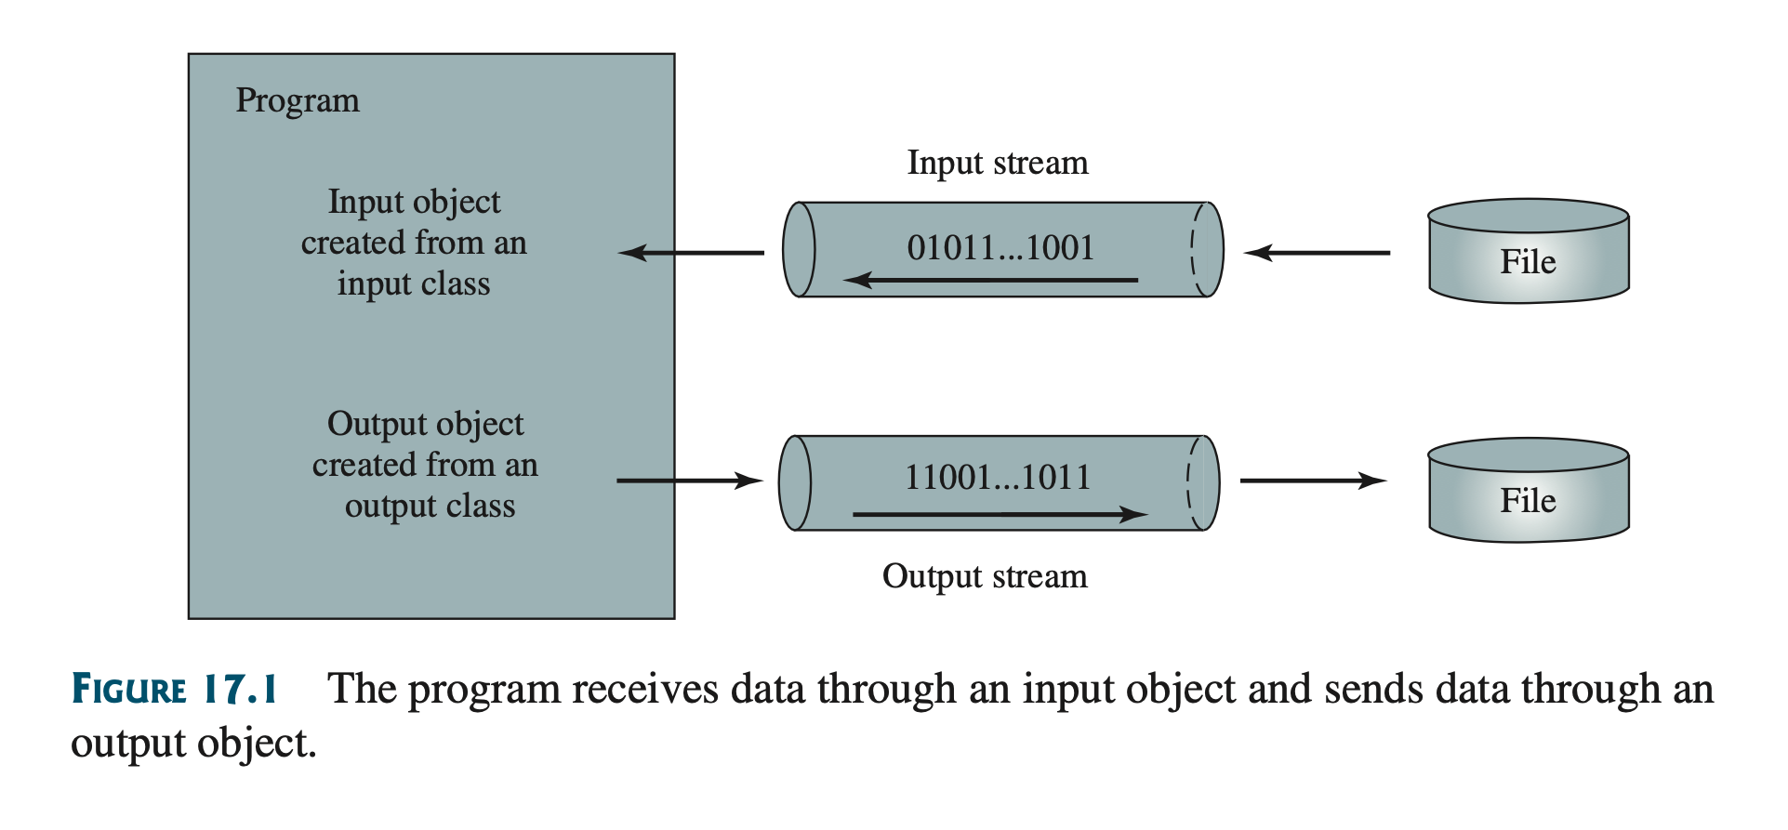
Stream
Communication between the program and the files is carried out by streams. An input object reads a stream of data from a file, and an output object writes a stream of data to a file. An input object is also called an input stream and an output object an output stream.
Scanner input = new Scanner(new File("temp.txt"));
System.out.println(input.nextLine());
PrintWriter output = new PrintWriter("temp.txt");
output.println("Java 101");
output.close();

Slide 8
Binary Files
Data stored in a text file is represented in human-readable form. Data stored in a binary file is represented in binary form. You cannot read binary files. They are designed to be read by programs. For example, Java source programs are stored in text files and can be read by a text editor, but Java classes are stored in binary files and are read by the JVM. The advantage of binary files is that they are more efficient to process than text files.

Slide 9
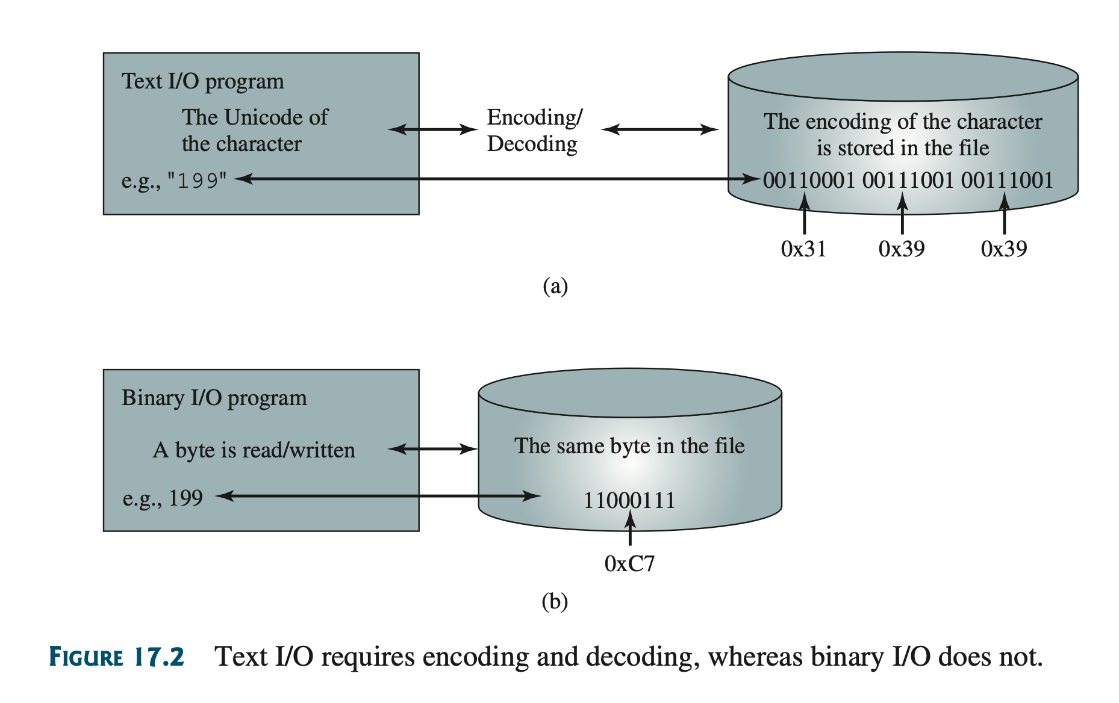
Binary Files
Computers do not differentiate between binary files and text files. All files are stored in binary format, and thus all files are essentially binary files. Text I/O is built upon binary I/O to provide a level of abstraction for character encoding and decoding. Encoding and decoding are automatically performed for text I/O.

Slide 10
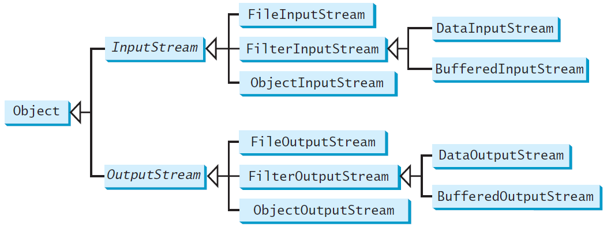
Binary I/O Classes

Slide 11
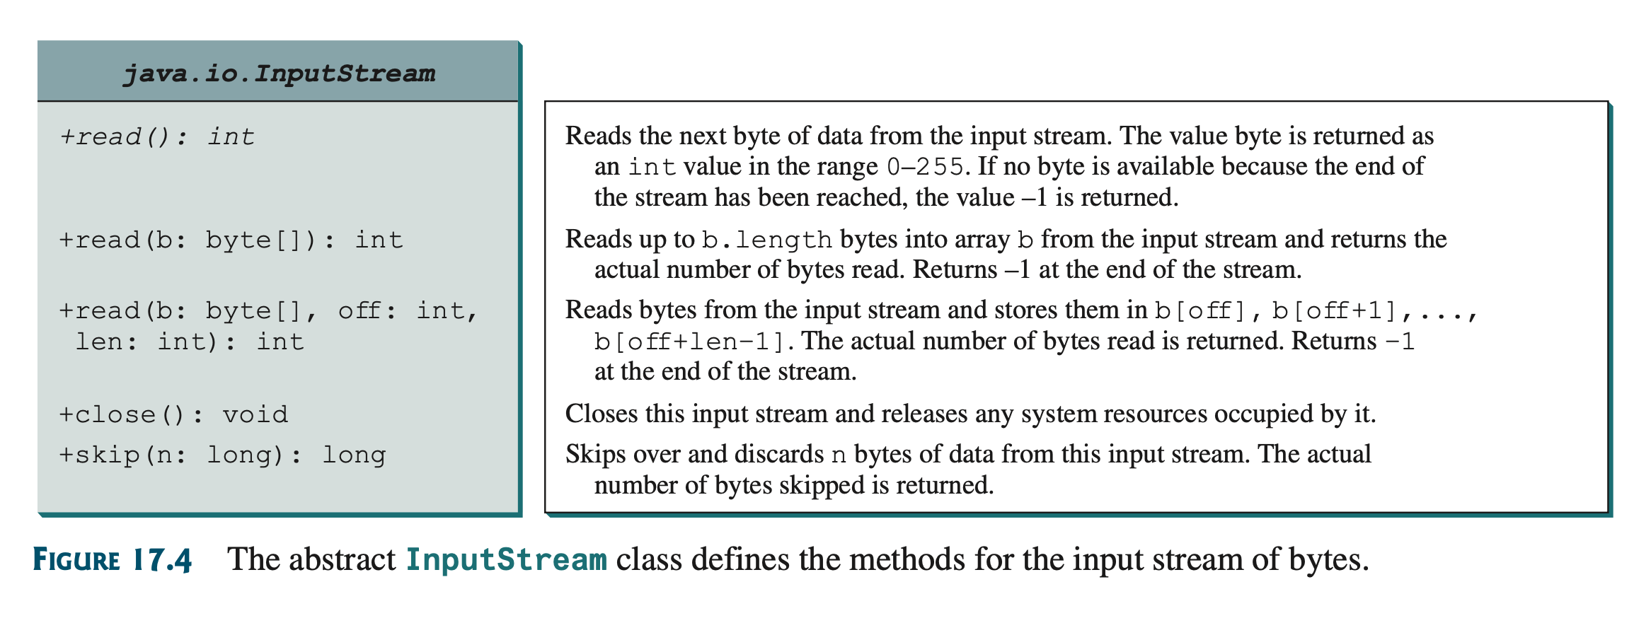
InputStream
A java.io.FileNotFoundException would occur if you attempt to create a FileInputStream with a nonexistent file.
The methods for InputStream are shown in below.
The value returned is a byte as an int type.

Slide 12
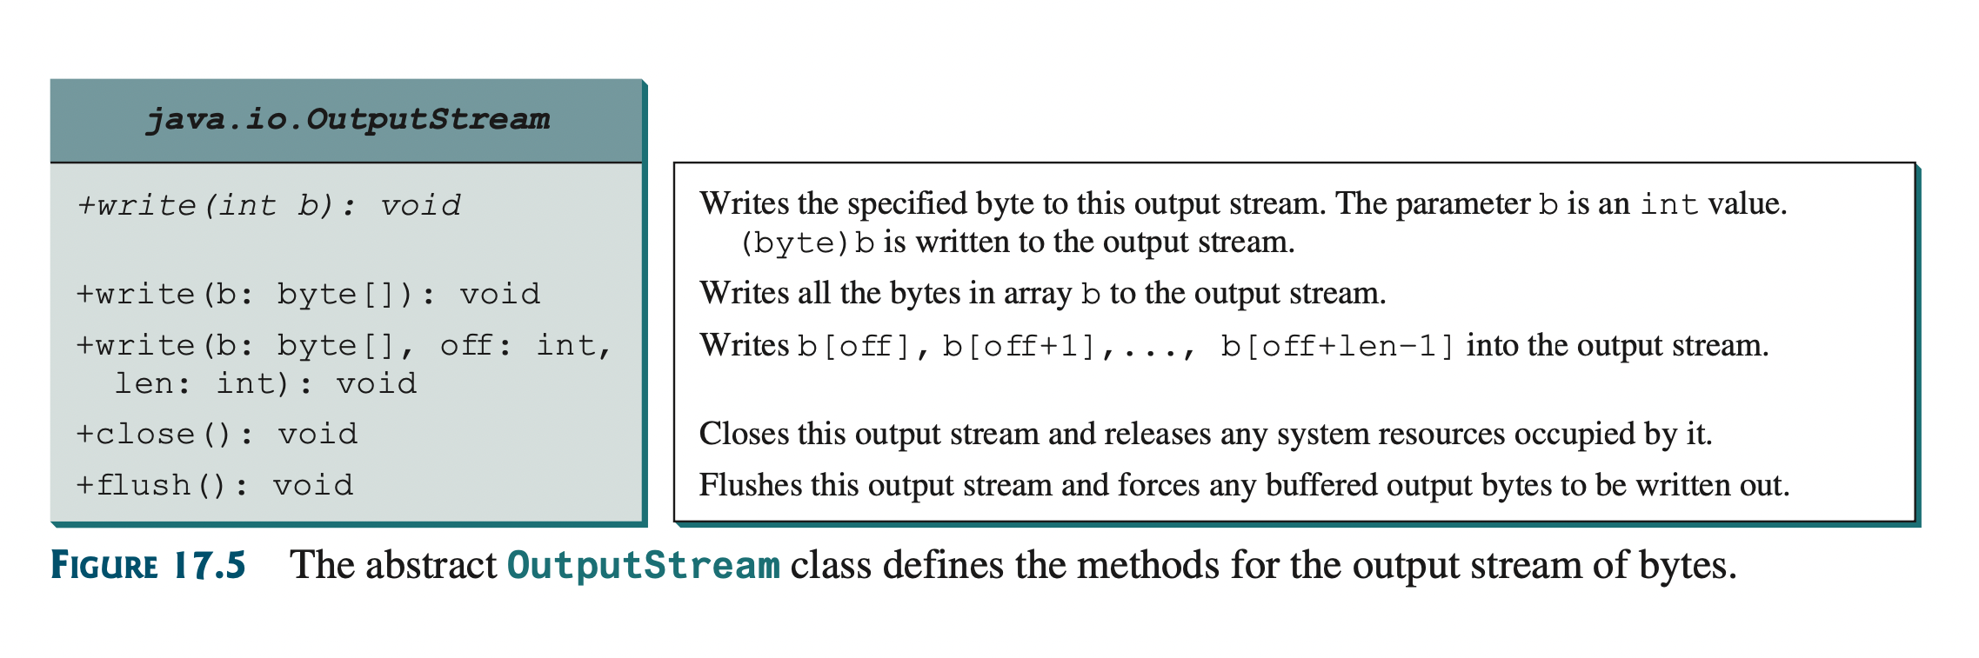
OutputStream
The methods for OutputStream are shown in below.

Slide 13
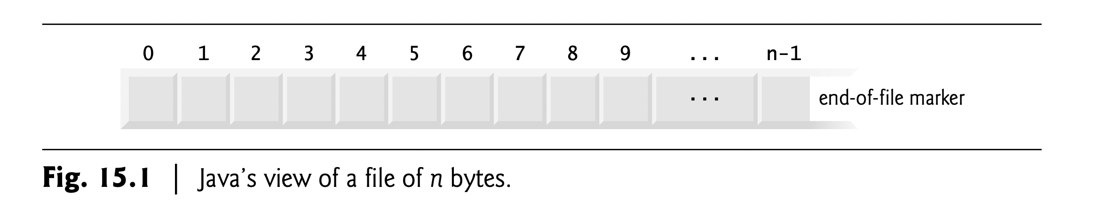
Stream
When you have created a new file with FileInputStream, it may be thrown java.io.FileNotFoundException.
FileInputStream input = new FileInputStream("temp.dat");
// Read values from the file
int value;
while ((value = input.read()) != −1)
System.out.print(value + " ");
TestFileStream
Run

Slide 14
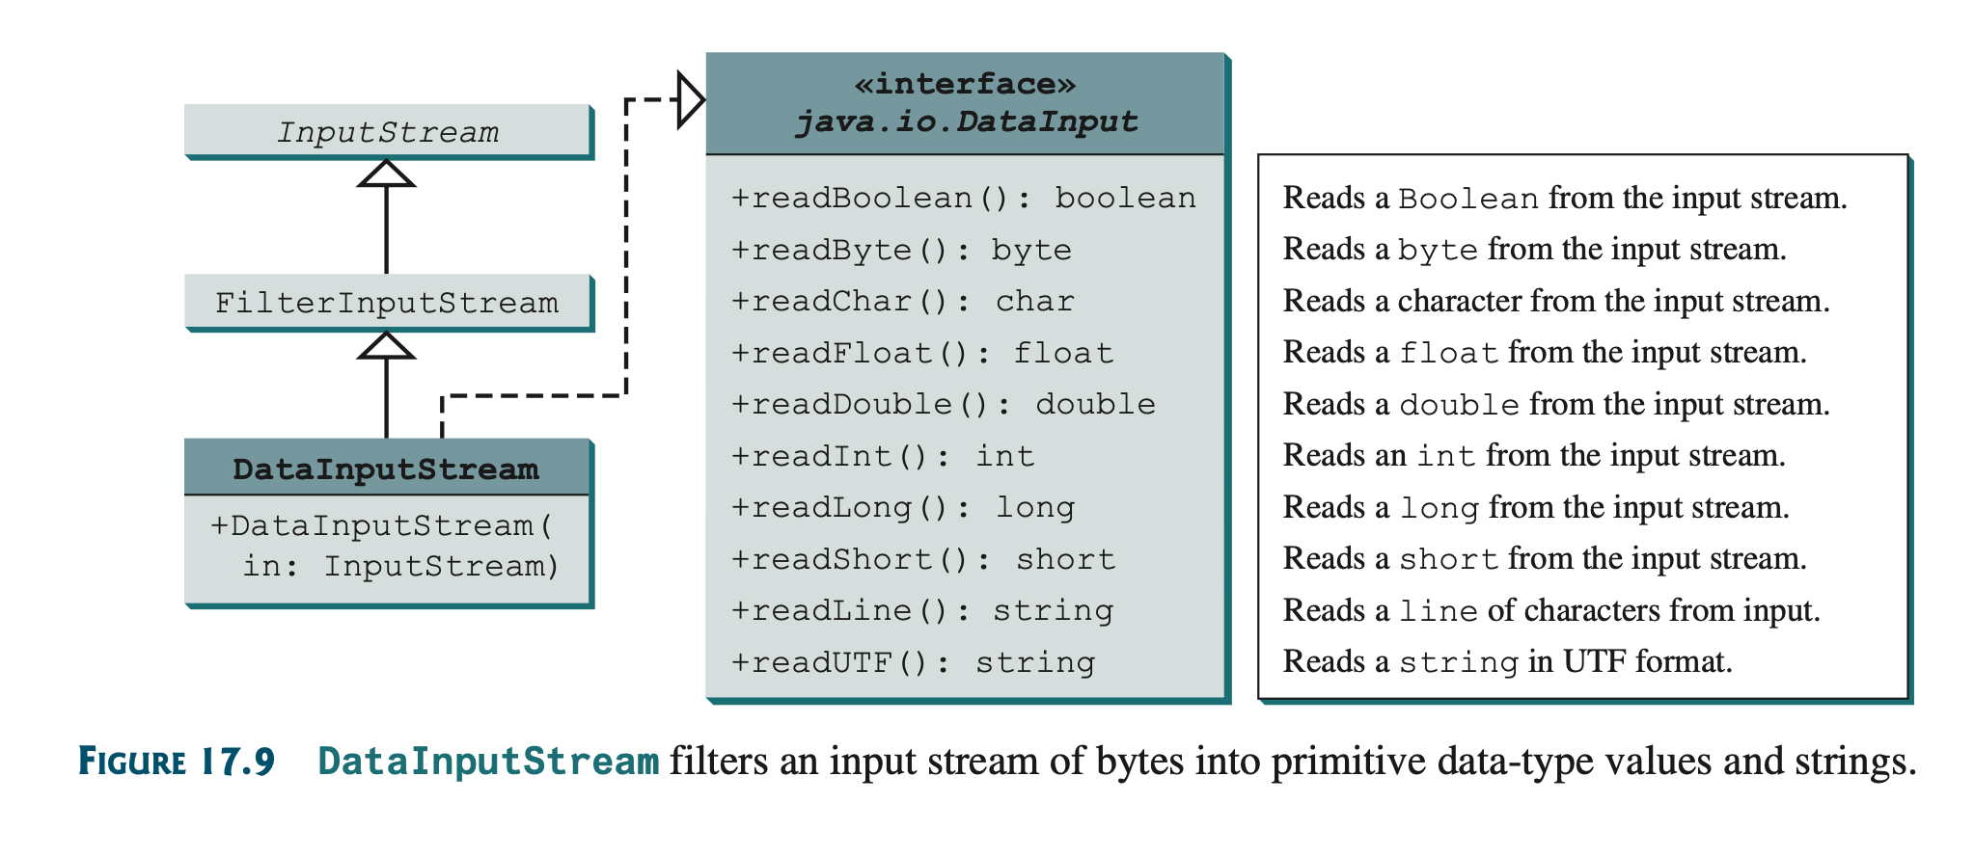
DataInputStream
DataInputStream reads bytes from the stream and converts them into appropriate primitive type values or strings.

Slide 15
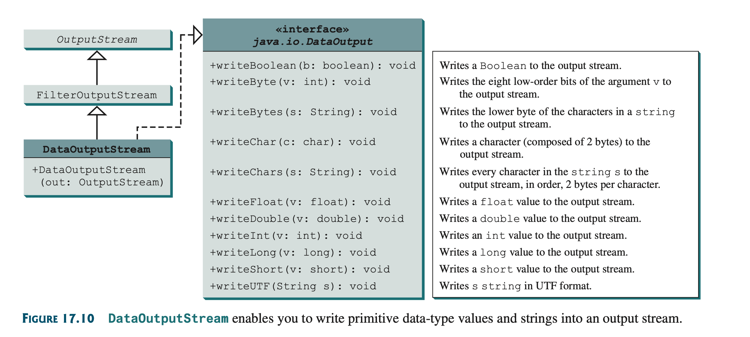
DataOutputStream
DataOutputStream converts primitive type values or strings into bytes and output the bytes to the stream.

Slide 16
Stream
writeUTF(String s) method writes String data in UTF format.
The writeUTF(String s) method writes a string using the UTF coding scheme. UTF is efficient for compressing a string with Unicode characters.

Slide 17
Stream
import java.io.*;
public class Test {
public static void main(String[] args) throws IOException {
try ( // Create an output stream for file temp.dat
DataOutputStream output =
new DataOutputStream(new FileOutputStream("temp.dat"));
) {
// Write student test scores to the file
output.writeUTF("John");
output.writeDouble(85.5);
output.writeUTF("Jim");
output.writeDouble(185.5);
output.writeUTF("George");
output.writeDouble(105.25);
}
try ( // Create an input stream for file temp.dat
DataInputStream input =
new DataInputStream(new FileInputStream("temp.dat"));
) {
// Read student test scores from the file
System.out.println(input.readUTF() + " " + input.readDouble());
System.out.println(input.readUTF() + " " + input.readDouble());
System.out.println(input.readUTF() + " " + input.readDouble());
}
}
}
TestDataStream
Run

Slide 18
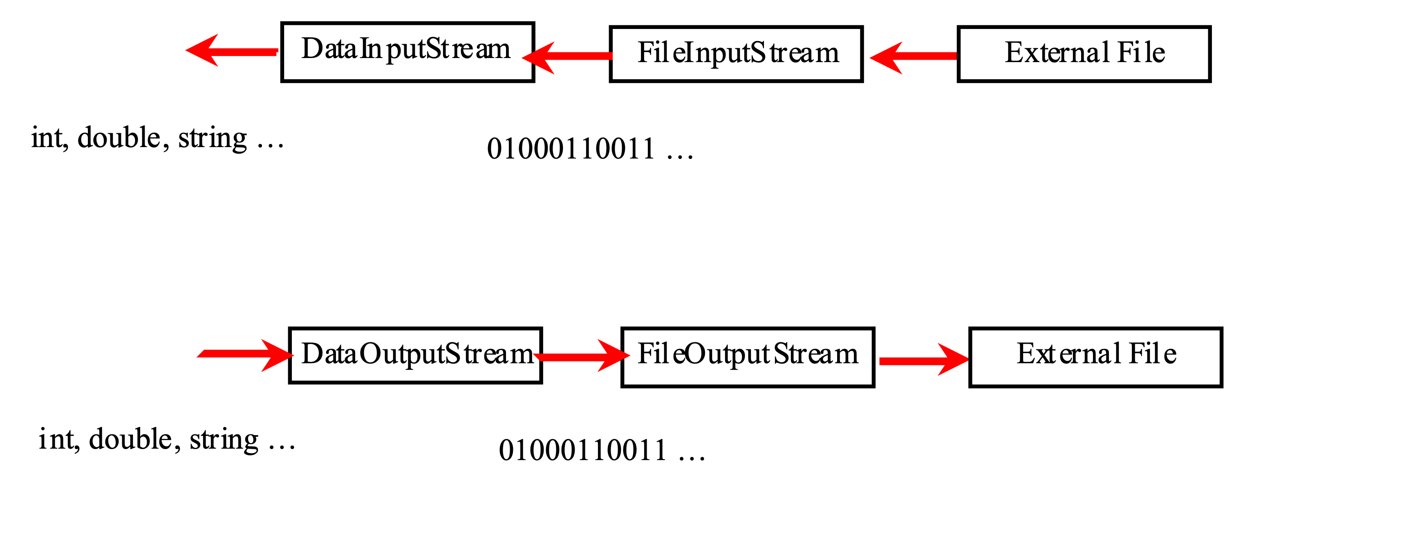
Concept of pipe line

Slide 19
Stream
End of file throws an exception. Thus, you should check if end of file (EOF) is reached.
import java.io.*;
public class DetectEndOfFile {
public static void main(String[] args) {
try {
try (DataOutputStream output =
new DataOutputStream(new FileOutputStream("test.dat"))) {
output.writeDouble(4.5);
output.writeDouble(43.25);
output.writeDouble(3.2);
}
try (DataInputStream input =
new DataInputStream(new FileInputStream("test.dat"))) {
while (true)
System.out.println(input.readDouble());
}
}
catch (EOFException ex) {
System.out.println("All data were read");
}
catch (IOException ex) {
ex.printStackTrace();
}
}
}

Slide 20
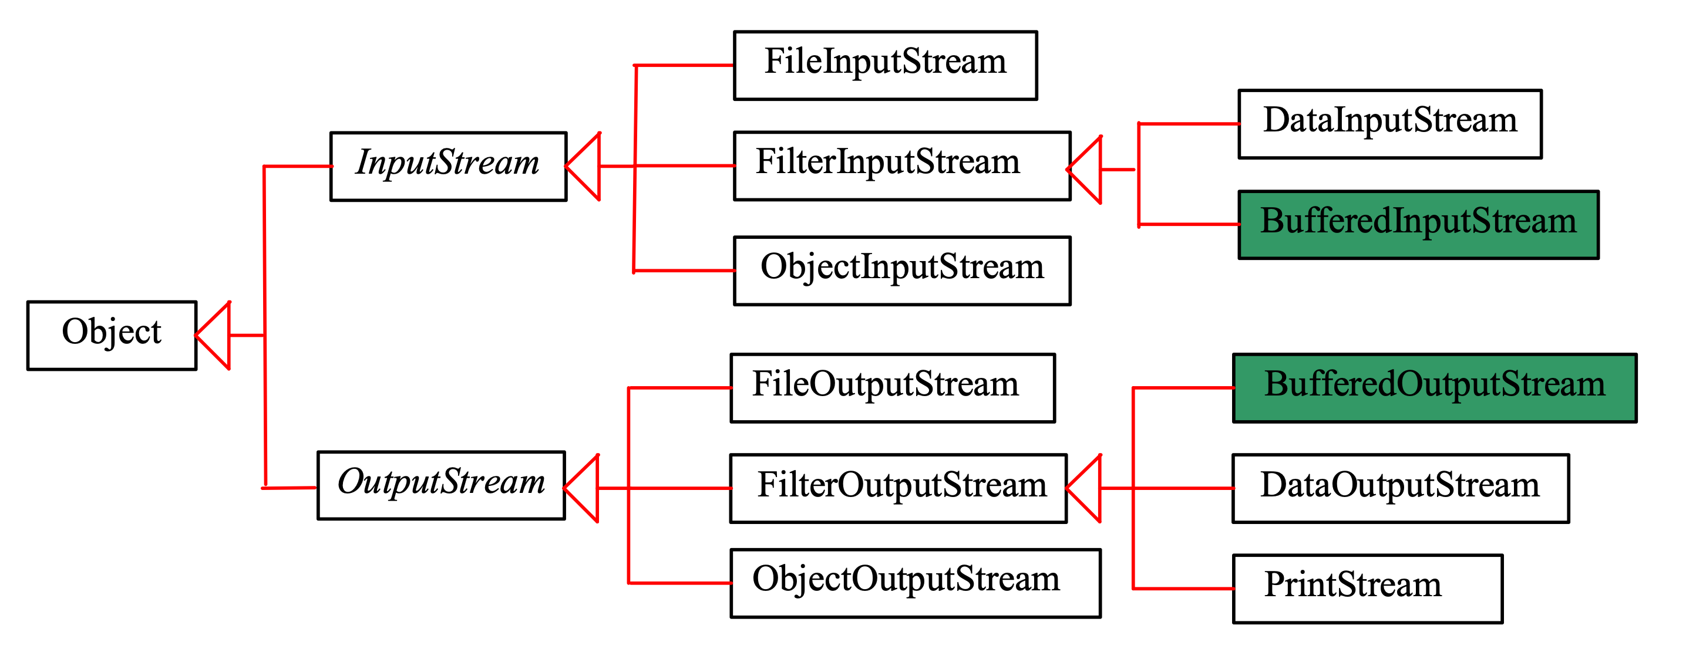
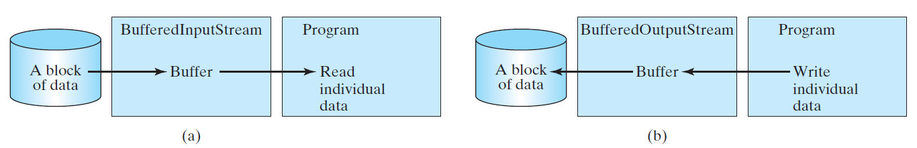
Stream
BufferedInputStream/BufferedOutputStream can be used to speed up input and output by reducing the number of disk reads and writes. Using BufferedInputStream, the whole block of data on the disk is read into the buffer in the memory once. The individual data are then loaded to your program from the buffer, as shown in Figure.

Slide 21
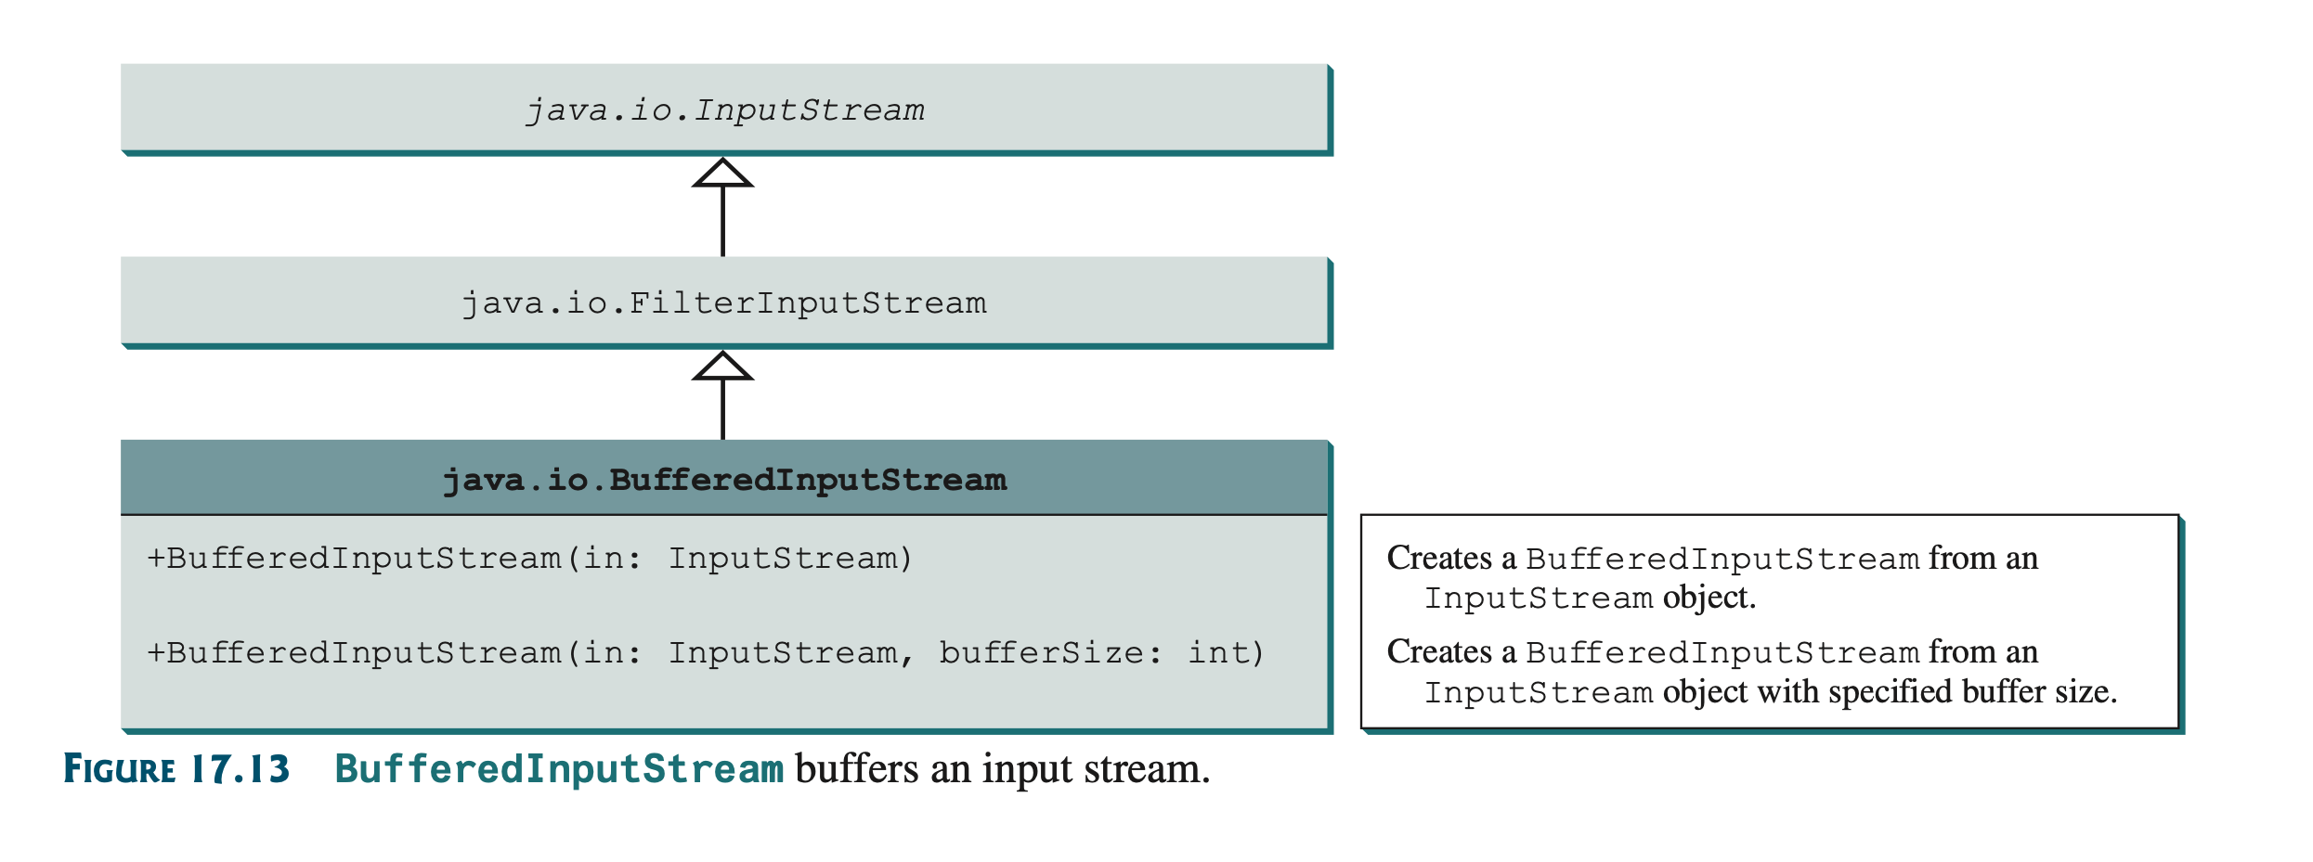
Stream

Slide 22
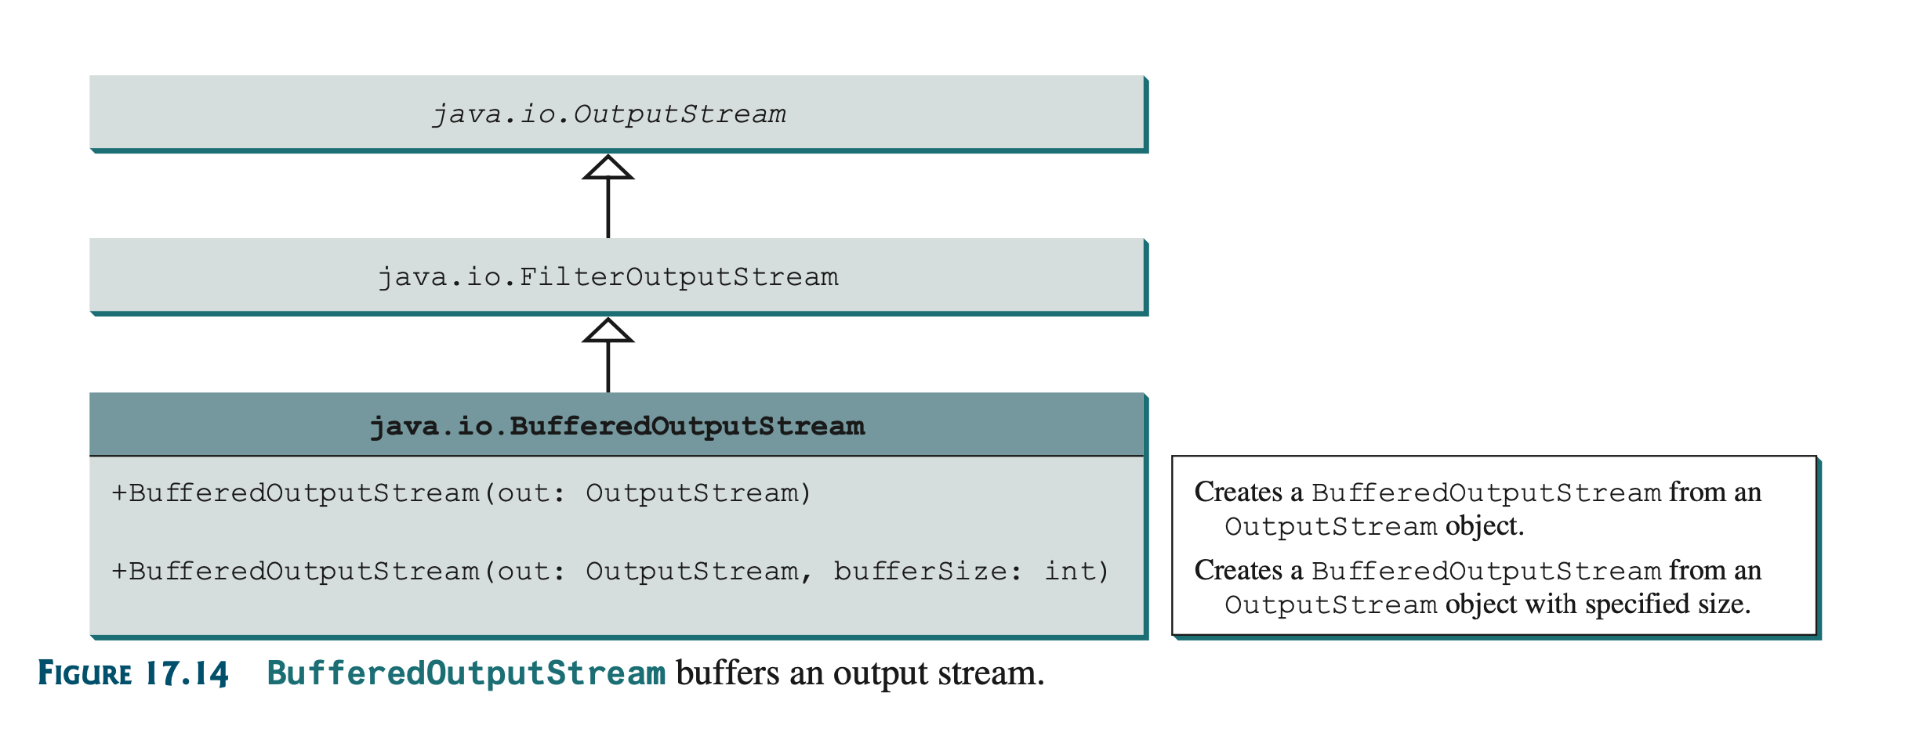
Stream
DataOutputStream output = new DataOutputStream( new BufferedOutputStream(new FileOutputStream("temp.dat")));
DataInputStream input = new DataInputStream( new BufferedInputStream(new FileInputStream("temp.dat")));

Slide 23
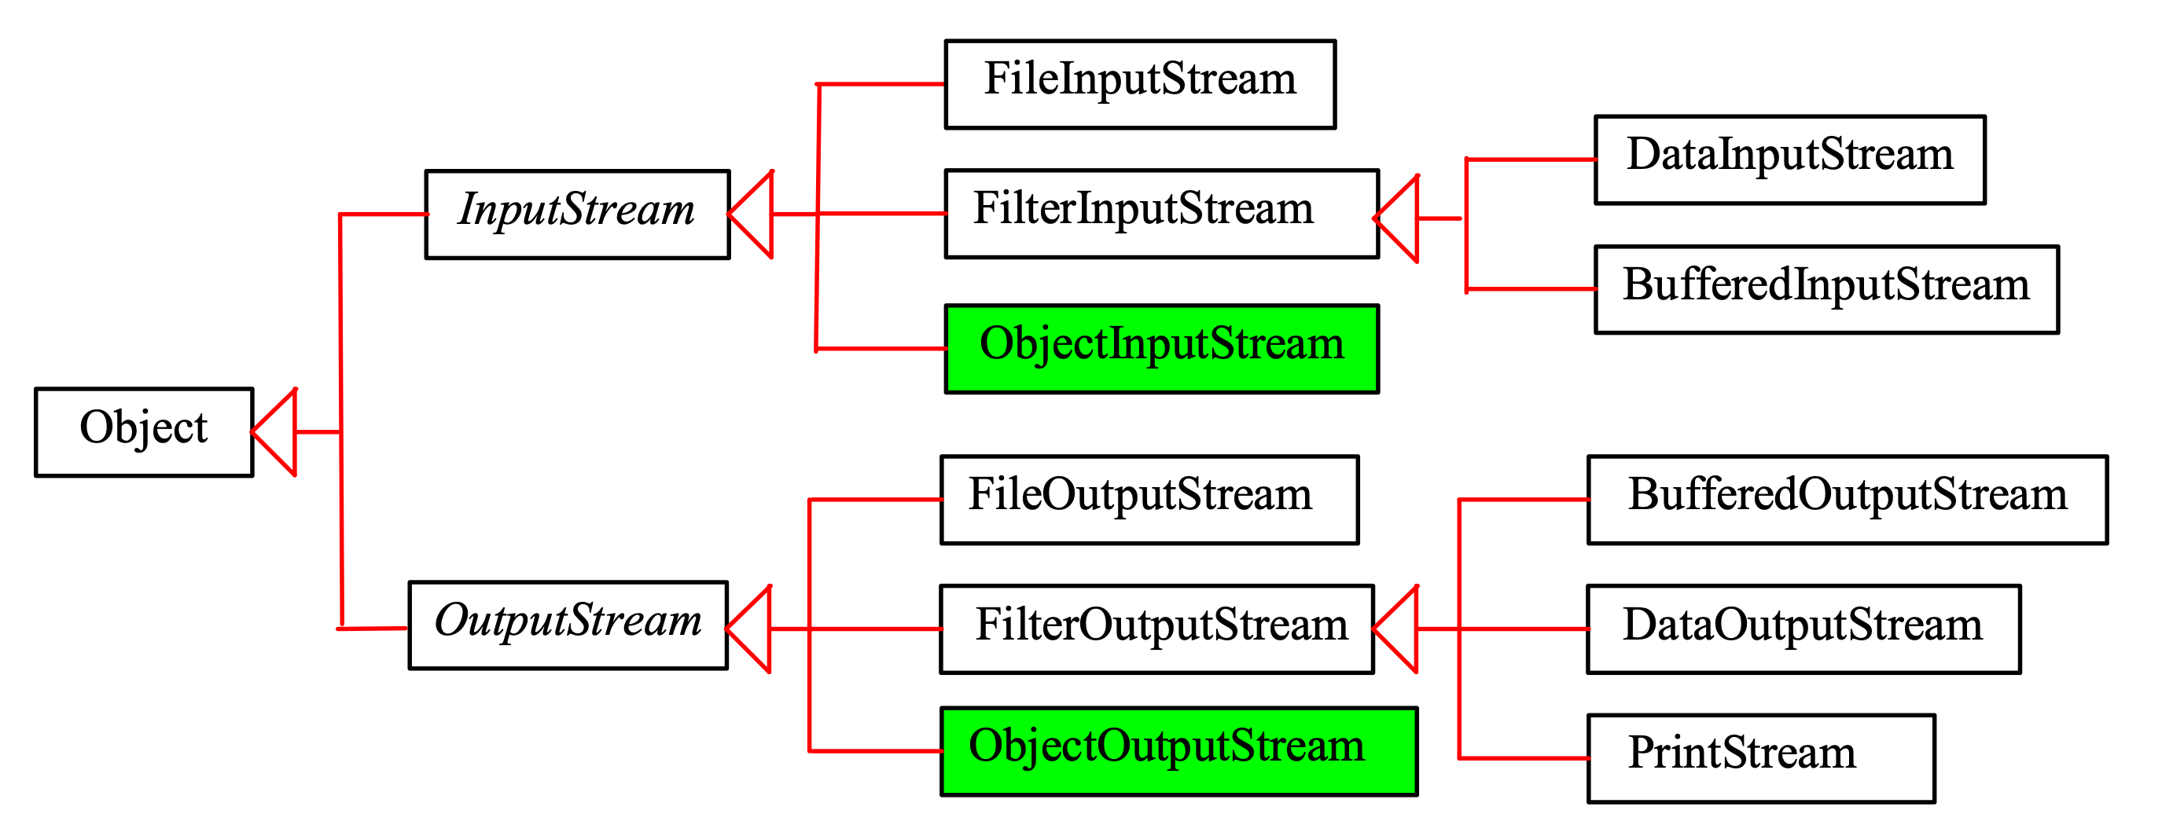
Object I/O
ObjectInputStream/ObjectOutputStream enables you to perform I/O for objects in addition for primitive type values and strings.

Slide 24
Object I/O
import java.io.*;
public class TestObjectOutputStream {
public static void main(String[] args) throws IOException {
try ( // Create an output stream for file object.dat
ObjectOutputStream output =
new ObjectOutputStream(new FileOutputStream("object.dat"));
) {
// Write a string, double value, and object to the file
output.writeUTF("John");
output.writeDouble(85.5);
output.writeObject(new java.util.Date());
}
}
}
TestObjectOutputStream
Run
TestObjectInputStream
Run

Slide 25
The Serializable Interface
Not all objects can be written to an output stream. Objects that can be written to an object stream is said to be serializable. A serializable object is an instance of the java.io.Serializable interface. So the class of a serializable object must implement Serializable.
The Serializable interface is a marker interface. It has no methods, so you don't need to add additional code in your class that implements Serializable.
Implementing this interface enables the Java serialization mechanism to automate the process of storing the objects and arrays.
java.io.Serializable library is used and implement Serializable keywords should be added to record structure.

Slide 26
Serializing Arrays
Let’s serialize an array.
import java.io.*;
public class TestObjectStreamForArray {
public static void main(String[] args)
throws ClassNotFoundException, IOException {
int[] numbers = {1, 2, 3, 4, 5};
String[] strings = {"John", "Susan", "Kim"};
try ( // Create an output stream for file array.dat
ObjectOutputStream output = new ObjectOutputStream(new
FileOutputStream("array.dat", true));
) {
// Write arrays to the object output stream
output.writeObject(numbers);
output.writeObject(strings);
}
try ( // Create an input stream for file array.dat
ObjectInputStream input =
new ObjectInputStream(new FileInputStream("array.dat"));
) {
int[] newNumbers = (int[])(input.readObject());
String[] newStrings = (String[])(input.readObject());
// Display arrays
for (int i = 0; i < newNumbers.length; i++)
System.out.print(newNumbers[i] + " ");
System.out.println();
for (int i = 0; i < newStrings.length; i++)
System.out.print(newStrings[i] + " ");
}
}
}
TestObjectStreamForArray
Run

Slide 27
Object I/O
import java.io.*;
import java.util.*;
import java.util.stream.IntStream;
import java.util.stream.Stream;
public class Dosyalar2 {
public static void main(String[] args) throws IOException, ClassNotFoundException
{
Ogrenci ogr=new Ogrenci("Veli", 90);
ObjectOutputStream cikti = new ObjectOutputStream(new FileOutputStream("dosya.txt"));
cikti.writeObject(ogr);
cikti.close();
ObjectInputStream girdi= new ObjectInputStream(new FileInputStream("dosya.txt"));
Ogrenci ogr2= null;
ogr2=(Ogrenci) girdi.readObject();
System.out.println(ogr2);
}
}
//Ogrenci.java
import java.io.Serializable;
public record Ogrenci(String adi, int notu) implements Serializable { }
dosya.txt
??srOgrenciInotuLaditLjava/lang/String;xpZtVeli
Ogrenci[adi=Veli, notu=90]

Slide 28
RANDOM ACCESS FILES

Slide 29
Random Access Files
All of the streams you have used so far are known as read-only or write-only streams. The external files of these streams are sequential files that cannot be updated without creating a new file. It is often necessary to modify files or to insert new records into files. Java provides the RandomAccessFile class to allow a file to be read from and write to at random locations.

Slide 30
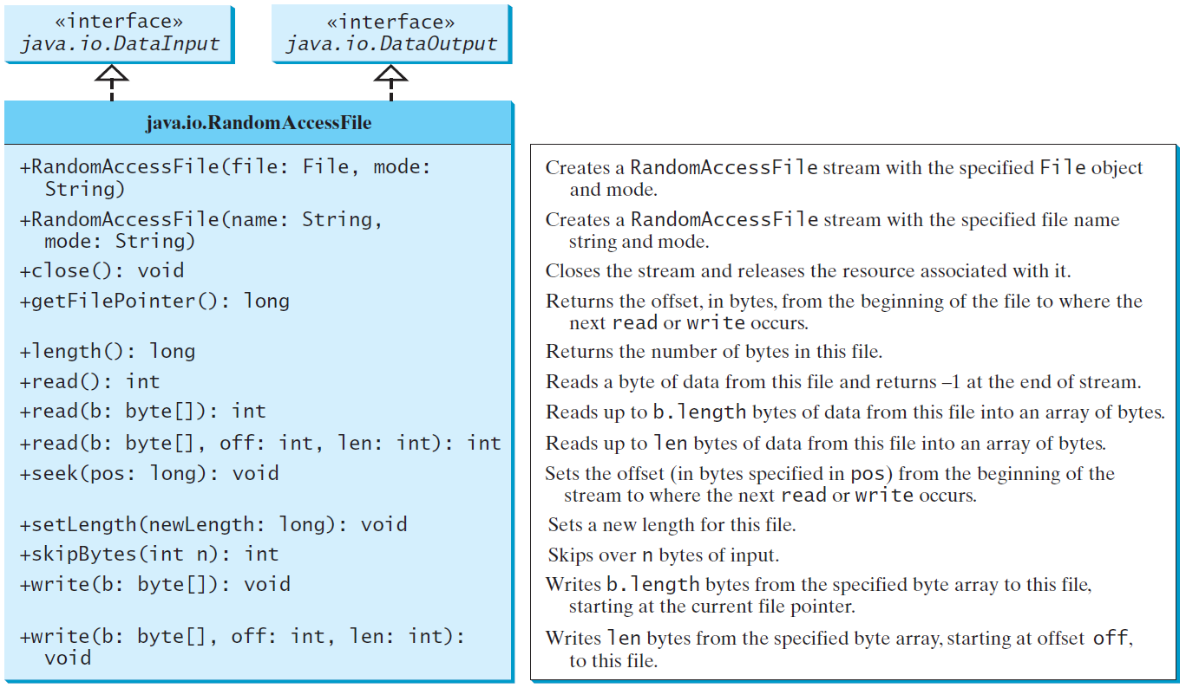
Random Access Files

Slide 31
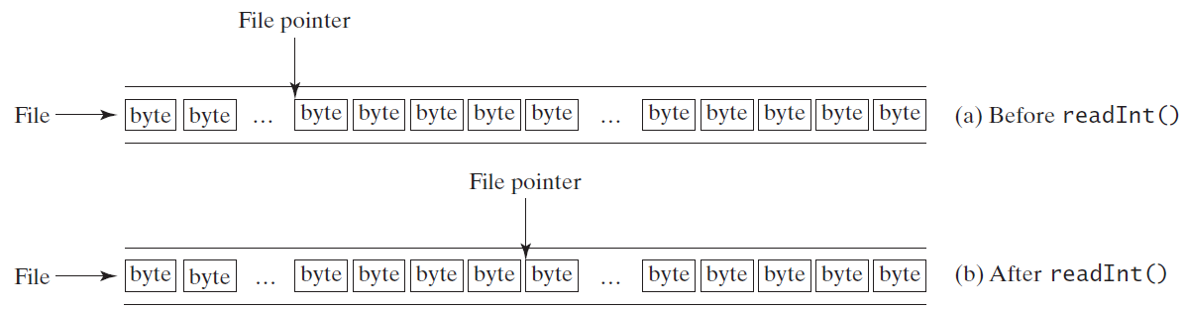
File Pointer
A random access file consists of a sequence of bytes. There is a special marker called file pointer that is positioned at one of these bytes. A read or write operation takes place at the location of the file pointer. When a file is opened, the file pointer sets at the beginning of the file. When you read or write data to the file, the file pointer moves forward to the next data. For example, if you read an int value using readInt(), the JVM reads four bytes from the file pointer and now the file pointer is four bytes ahead of the previous location.

Slide 32
Random Access File
import java.io.*;
public class TestRandomAccessFile {
public static void main(String[] args) throws IOException {
try ( // Create a random access file
RandomAccessFile inout = new RandomAccessFile("inout.dat", "rw");
) {
// Clear the file to destroy the old contents if exists
inout.setLength(0);
// Write new integers to the file
for (int i = 0; i < 200; i++)
inout.writeInt(i);
// Display the current length of the file
System.out.println("Current file length is " + inout.length());
// Retrieve the first number
inout.seek(0); // Move the file pointer to the beginning
System.out.println("The first number is " + inout.readInt());
// Retrieve the second number
inout.seek(1 * 4); // Move the file pointer to the second number
System.out.println("The second number is " + inout.readInt());
// Retrieve the tenth number
inout.seek(9 * 4); // Move the file pointer to the tenth number
System.out.println("The tenth number is " + inout.readInt());
// Modify the eleventh number
inout.writeInt(555);
// Append a new number
inout.seek(inout.length()); // Move the file pointer to the end
inout.writeInt(999);
// Display the new length
System.out.println("The new length is " + inout.length());
// Retrieve the new eleventh number
inout.seek(10 * 4); // Move the file pointer to the eleventh number
System.out.println("The eleventh number is " + inout.readInt());
}
}
}
TestRandomAccessFile
Run

Slide 33
Aggregate Operations for Collection Streams

Slide 34
Collection of Stream
A collection stream or simply stream is a sequence of elements. The operations on a stream is called aggregate operations (also known as stream operations) because they apply to all the data in the stream. The filter and count are the examples of aggregate operations.
The code written using a foreach loop describes the process how to obtain the count, that is, for each element, if it is greater than 60, increase the count. The code written using the aggregate operations tells the program to return the count for the elements greater than 60, but it does not specify how the count is obtained.
Clearly, using the aggregate operations leaves the detailed implementation to the computer, therefore, makes the code concise and simpler. Moreover, the aggregate operations on a stream can be executed in parallel to take advantage of multiple processors. So, the code written using aggregate operations usually run faster than the ones using a foreach loop.

Slide 35
Aggregate Operations for Collection Streams
Double[] numbers = {2.4, 55.6, 90.12, 26.6};
Set<Double> set = new HashSet<>(Arrays.asList(numbers));
int count = 0;
for (double e: set)
if (e > 60) count++;
System.out.println("Count is " + count);
System.out.println("Count is " + set.stream().filter(e −> e > 60).count());
public static int(int e)
{
if (e>60) return e;
}

Slide 36
Stream Pipelines
A stream pipeline consists of a stream created from a data source, zero or more intermediate methods, and a final terminal method.

Slide 37
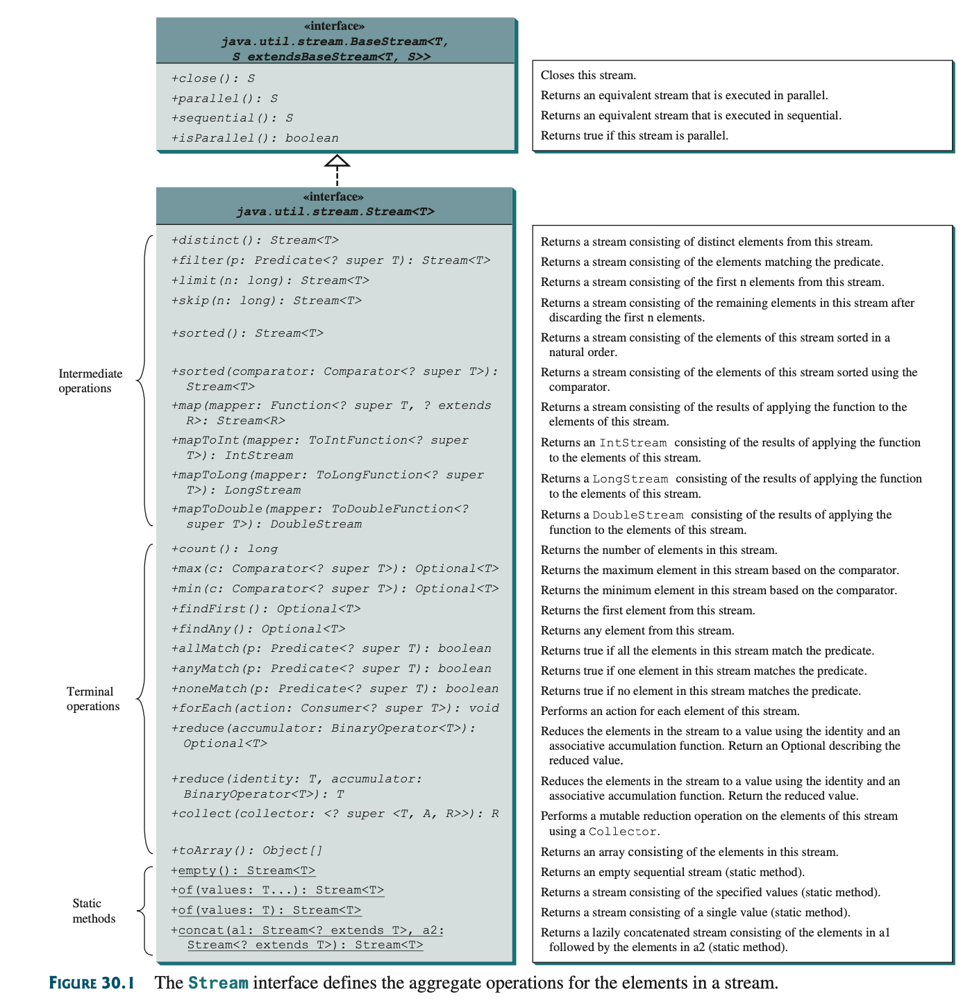
Stream Pipelines

Slide 38
Stream Pipelines
The methods in the Stream interface are divided into three groups: intermediate methods, terminal methods, and static methods.
An intermediate method transforms the stream into another stream.
A terminal method returns a result or performs actions. After a ter- minal method is executed, the stream is closed automatically.
A static method creates a stream.

Slide 39
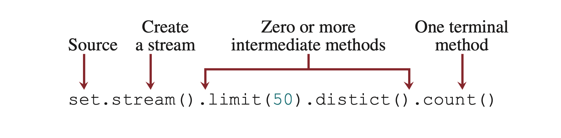
Stream Pipeline
The methods are invoked using a stream pipeline. A stream pipeline consists of a source (e.g., a list, a set, or an array), a method that creates a stream, zero or more intermediate methods, and a final terminal method. The following is a stream pipeline example:
distinct
Here, set is the source of the data, invoking stream() creates a stream for the data from the source, invoking limit(50) returns the first 50 elements from the stream, invoking distinct() obtains a stream of distinct elements from the stream of the 50 elements, and invoking count() returns the number of elements in the final stream.

Slide 40
Collection Stream
import java.util.*;
public class TopluStream {
public static void main(String[] args)
{
List <String> a = new ArrayList<String>();
a.add("Ali");
a.add("Ayse");
a.add("Zeynep");
a.add("Mehmet");
a.stream().filter((s) -> s.startsWith("A"))
.map(String::toUpperCase)
.forEach(System.out::println);
}
}
ALI
AYSE

Slide 41
Stream Pipelines
Streams are lazy, which means that the computation is performed only when the terminal operation is initiated. This allows the JVM to optimize computation.
Most of the arguments for stream methods are instances of functional interfaces. So the arguments can be created using lambda expressions or method references.

Slide 42
Collection Stream
import java.util.*;
public class TopluStream {
public static void main(String[] args)
{
List <String> a = new ArrayList<String>();
a.add("Ali");
a.add("Ayse");
a.add("Zeynep");
a.add("Mehmet");
a.stream().filter((s) -> s.startsWith("A"))
.map(String::toUpperCase)
.forEach(System.out::println);
System.out.println("\n\n");
a.stream().sorted()
.map(String::toUpperCase)
.forEach(System.out::println);
}
}
ALI
AYSE
ALI
AYSE
MEHMET
ZEYNEP

Slide 43
Stream Reduction Using the reduce Method
You can use the reduce method to reduce the elements in a stream into a single value. Often you need to process all the elements in a collection to produce a summary value such as the sum, the maximum, or the minimum.
A reduction takes the elements from a stream to produce a single value by repeated application of a binary operation such as addition, multiplication, or finding the maximum between two elements. Using reduction, you can write the code for finding the sum of all elements in a set as follows:
int sum = s.stream().reduce(0, (e1, e2) −> e1 + e2);
Here, the reduce method takes two arguments. The first is an identity, that is, the starting value. The second argument is an object of the functional interface IntBinaryOperator.
reduce(0, new java.util.function.IntBinaryOperator() {
public int applyAsInt(int e1, int e2)
{ return e1 + e2; } }
)

Slide 44
Stream Reduction Using the reduce Method
import java.util.*; public class TopluStream { public static void main(String[] args) { List <String> a = new ArrayList<String>(); a.add("Ali"); a.add("Ayse"); a.add("Zeynep"); a.add("Mehmet"); a.stream().filter((s) -> s.startsWith("A")) .map(String::toUpperCase) .forEach(System.out::println); System.out.println("\n\n"); a.stream().sorted() .map(String::toUpperCase) .forEach(System.out::println); System.out.println("\n\n"); Optional <String> b= a.stream().reduce((s1, s2) -> s1 + "--" + s2); System.out.println(b); } }
ALI
AYSE
ALI
AYSE
MEHMET
ZEYNEP
Optional[Ali--Ayse--Zeynep--Mehmet]

Slide 45
Stream Reduction Using the collect Method
You can use the collect method to reduce the elements in a stream into a mutable container.

Slide 46
Stream Reduction Using the collect Method
import java.util.*; import java.util.stream.Collectors; import java.util.stream.IntStream; public class TopluStream { public static void main(String[] args) { String[] isimler = {"Ali", "Ayşe", "Fatma"};
System.out.println(Arrays.stream(isimler).collect(Collectors.toList())); } }
1
2
3
4

Slide 47
IntStream, LongStream ve DoubleStream
IntStream, LongStream, and DoubleStream are special type of streams for processing a sequence of primitive int, long, and double values.
Additionally, you can use the sum(), average(), and summary Statistics()methods for returning the sum, average, and various statistics of the elements in the stream. You can use the mapToInt method to convert a Stream to an IntStream and use the map method to convert any stream including an IntStream to a Stream.

Slide 48
IntStream, LongStream ve DoubleStream
import java.util.*; import java.util.stream.IntStream; public class TopluStream { public static void main(String[] args) { IntStream.range(1,10) .forEach(System.out::println); } }
1
2
3
4

Slide 49
IntStream, LongStream ve DoubleStream
import java.util.*; import java.util.stream.IntStream; public class TopluStream { public static void main(String[] args) { int [] sayilar = new int[100]; sayilar = IntStream.range(0,99).toArray(); Arrays.stream(sayilar).limit(10) .filter(value -> value>4) .forEach(e -> System.out.println(e)); } }
1
2
3
4

Slide 50
Koleksiyonlarda Stream
There is a very comprehensive continuation of this issue.

Slide 51

Homework - 1
Write a program with binary files. Describe your problem in one paragraph.

Slide 52
Next Lecture
Midterm.

Slide 53
Programming Session
Quiz # 1
Files

Slide 54
Summary
We have learned binary and random Access files.
In next week, your midterm exam is planned.

Slide 55
Next Lecture
The next lesson, we will continue.

